Slide 1
Customer Purchase Behaviour
By :- Chris Aloysius Dmello

Slide 2
Agenda
Overview Of Sales
Product Affinity
Customer Segmentation
Recommendation

Slide 3
Sales Overview

Slide 4
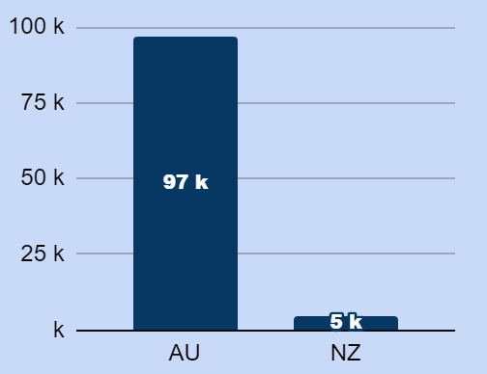
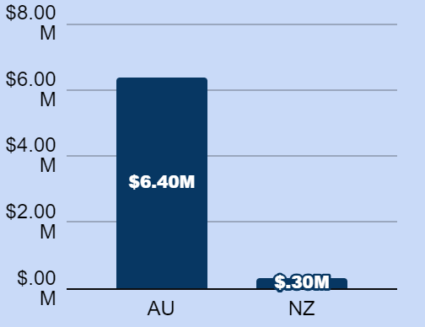
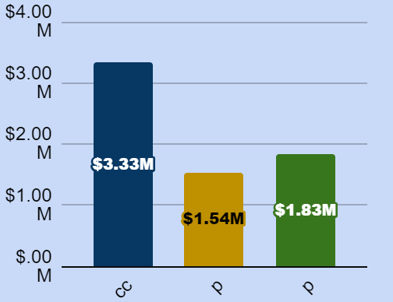
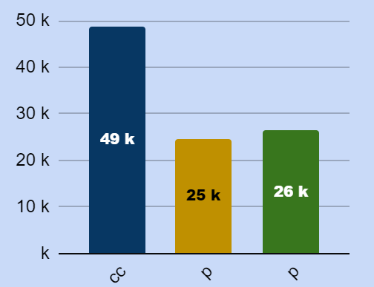
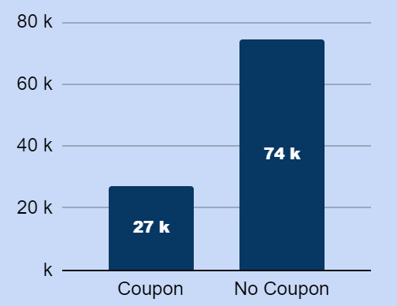
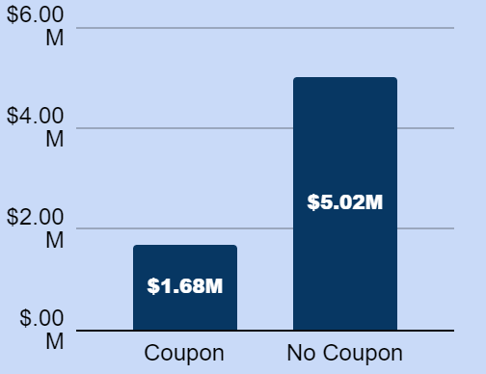
Summary : Overall Revenue Is Driven By NCpn Txns
Australia contributed to 6.3M sales and New Zealand to 300K. The New South Wales is the highest sales Province 3M.
For October non coupon sales are predominant. SPRING was the predominant coupon.
Braintree accounted for highest revenue/sales.
It was observed that No Payment Option was available. Assumed it was COD. .
Quantity
Revenue
Payment- Revenue
Payment- Quantity
CPN- Quantity
CPN- Revenue
cc@braintree
paypal@braintree
pbi@afterpay

Slide 5
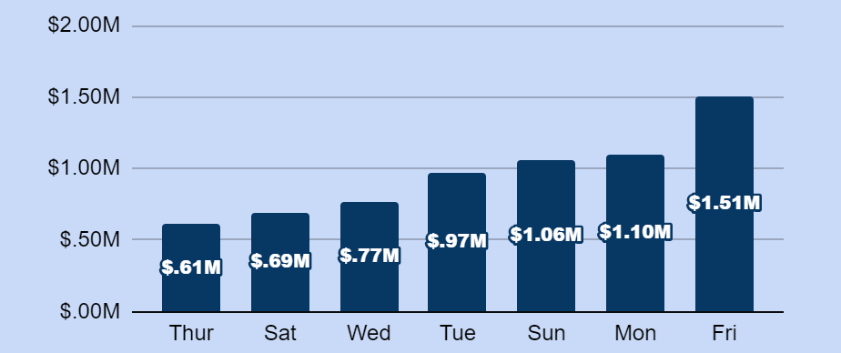
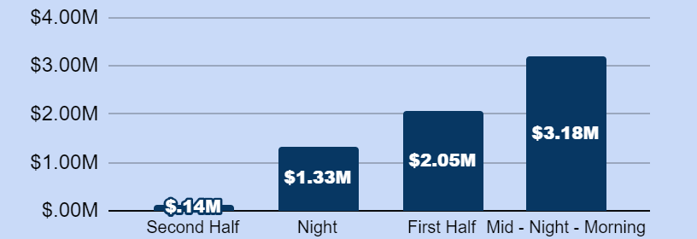
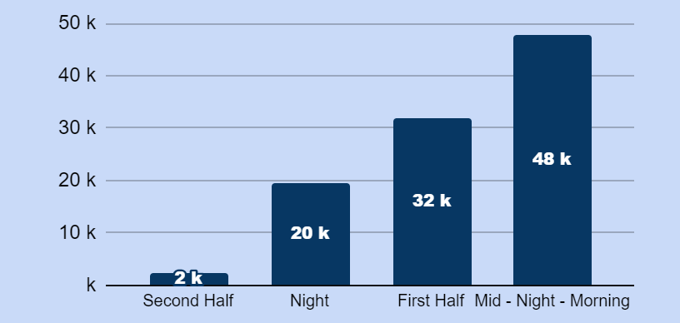
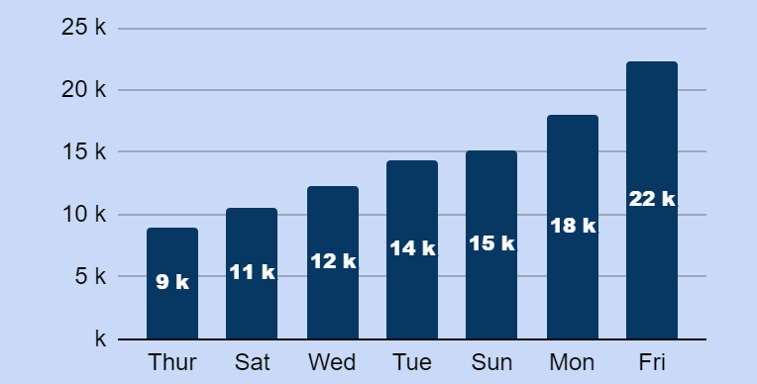
Summary : Weekends and Late Night Shoppers Drive Sales
Fridays contribute to 22.5 % and 21.9 Quantity. 25% of revenue from coupon transactions on Fridays.
Post Mid night, there is rise in sales driven by women shoppers.
Total transaction from Oct-01 to Oct-21 is 49.99K.
Revenue
Revenue
Quantity
CPN- Revenue
0-7 Midnight-Morning, 8-13 First Half, 14-17 Second Half, >17 Night

Slide 6
Summary : Coupons help increase basket value by 7%
Average Revenue Per Order is $134, and Average Quantity Per Order is 2.
Female shoppers have a higher basket as expected.
Coupon Txns have drive higher sales, with 2.28 quantity per basket as compared to 1.95 of non coupon.
Hour Bracket | Quantity/Txns | Revenue/Txns
Second Half | 2.25 | $144.80
Night | 2.00 | $136.11
First Half | 2.11 | $135.61
Mid - Night - Morning | 1.99 | $131.74
Day Of Week | Quantity | Revenue
Thursday | 2.01 | $137.25
Sunday | 1.96 | $135.90
Friday | 2.00 | $135.42
Saturday | 2.06 | $134.76
Tuesday | 1.98 | $134.00
Monday | 2.15 | $131.34
Wednesday | 2.07 | $129.67
Gender | Quantity/Txns | Revenue/Txns
Maie | 2.02 | $135.41
Female | 2.07 | $124.59
Hour Bracket | Quantity/Txns | Revenue/Txns
Coupon | 2.28 | $141.33
No Coupon | 1.95 | $131.11
0-7 Midnight-Morning, 8-13 First Half, 14-17 Second Half, >17 Night

Slide 7
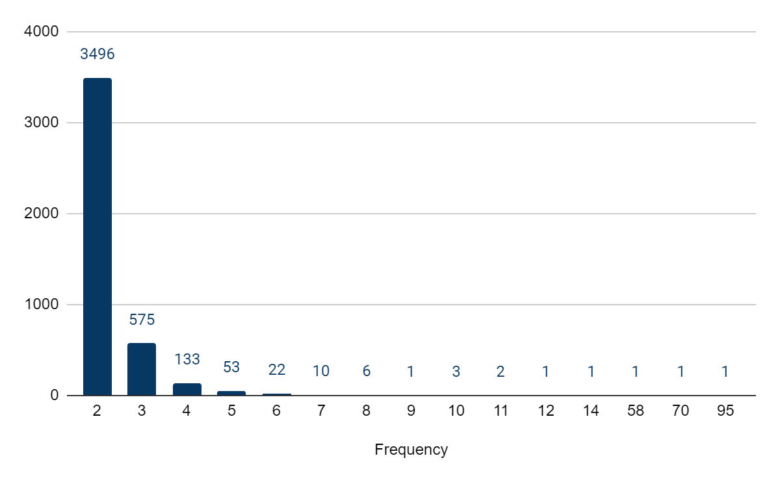
Summary:Multi Txns Customers tend to shop twice a month
90% of customers are single txns customers.
2.33 is the average frequency of multi-txns customers
There are customer with high frequency like 42189 (User ID), who are shifting the frequency to 2.33
80% users have frequency of 2.
Shoppers with 2 txns per month top the charts

Slide 8
Product Affinity

Slide 9
Summary : Women Shoppers Can Be Targeted More Accurately Using Product Affinity To Generate Revenue
One month Data doesn’t provide enough insight to recommend products with high confidence.
We have used the # of common transactions and quantity sold as a combination of metric to arrive at these recommendation.
Below is a snapshot of recommendation.
Antecedent | Consequent
Leco 7/8 Long Cardigan | Jourdan
Little Edee Denim Skirt | Nora Twisted Top
Lennox Bikini Top | Mr Smith Bikini Bottoms
Maui Rib Bikini Briefs | Little Edee Denim Skirt
Scoop Bralette Bikini | Bodhi Top
Michigan High-Waisted Pants | Noa Top

Slide 10
Customer Segmentation

Slide 11
Summary : Segmentation Based On Customer Preference
Multi-Txns
Coupon Preferred
Outlier
These are High Value Customers and very important to business.
4.2 K Customers (10%), AOV $145 and 2.1Quantity/Txns.
$1.39M revenue and 20K Quantity sold. Contributes 21% of overall Revenue.
These customers prefer coupons and have at least one coupon txns.
9.3K Customers (21%), AOV $140 and 2.24 Quantity/Txns.
$1.3M revenue and 21K Quantity Sold. 20 % of overall Revenue
These customers have 0 revenue but 2K quantity.
0.9K Customers(2%), AOV 0 and 1.8 Quantity/Txns.
$0.00 revenue and 2K Quantity sold..
MidNight Shoppers
Early Birds
Family Timers
These customers BINGE shop late and are a major segment.
14K Customers (33%), AOV $ 131 and 1.89 Quantity/Txns.
$1.89M revenue and 27K Quantity sold. Contributes 28% of overall Revenue.
The customers shop early in the day and we need to incentivise them more.
8.9K Customers(20%), AOV $135 and 2.03Quantity/Txns.
$1.22M revenue and 18K Quantity sold. Contributes 18% of overall Revenue.
Customer Shop late at in the second half of the day.
6.3K Customers(14%), AOV $135 and 1.94 Quantity/Txns
$0.87M revenue and 12K Quantity sold. Contributes
13% of overall Revenue.
AOV - Average Basket Size

Slide 12
Media Recommendation Strategy

Slide 13
Summary : Customer Segments Define Targeting Strategy
Multi-Txns
Coupon Preferred
Outlier
Multi transaction customers are self driven buyers and transact more.
The recommendation would be to send across regular coupons and promotional mailers and recommend product mix through affinity.
These customers prefer coupons and have transacted using coupon.
Hence sending across 20% to 30% coupons in regular interval.
There needs to be just enough juice to keep them occupied.
Further analysis/data needed to work on these customers.
MidNight Shoppers
Early Birds
Family Timers
Majority shoppers are female in this segment and fashion shoppers.
Aggressive and effect product recommendation, will lead to continuous sales.
These are cash cows.
These customers shop according to their need.
Upselling products, and cross selling, might yield effective results.
Promotions and Advertisements in family programs effectively pull these customer to buy.
More of family inclusive product mix recommendation.

